Slide 1


Exam Question Practice
Explain 2 characteristics of Random Access Memory (4 marks)

Slide 2
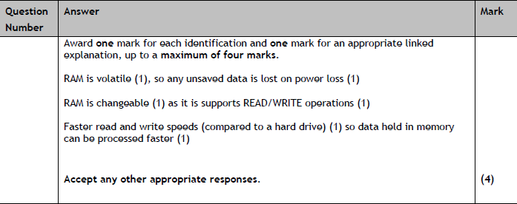
Exam Question Practice
Explain 2 characteristics of Random Access Memory (4 marks)

Slide 3
Exam Question Practice
What does good look like?
“All data is lost when the RAM is no longer powered on, volatile”
“RAM is very fast”
2/4 marks

Slide 4
Exam Question Practice
What does good look like?
“Random Access Memory is volatile. If it loses power (if a device turns off), all the memory within the RAM is lost”
“Random Access Memory is very fast as it has to load any programs that are currently being used. It is considerably faster than any form of secondary memory storage (such as a HDD or an SSD)
4/4 marks

Slide 5

Building and maintaining resilient digital environments

Slide 6

Recap
What is SaaS?
What does the application layer of the OSI model do?
What is meant by private cloud?
What are the 2 types of hypervisor?
What’s a drawback of virtualisation?
Notes:
SaaS: Software as a service, hosted platform such as teams, spotify
Application Layer: This is what the user sees i.e. messages, webpage etc
Private cloud: Cloud owned and used by 1 organization only
Bare Metal Hypervisor (HV runs directly on device, no OS), Hosted (Runs on top of another operating system)
Virtualisation drawbacks: resources are shared meaning that if they are all used by one device, performance can suffer, there can be slower execution of tasks, there can also be a higher hardware load

Slide 7

Learning Objectives
Define what a resilient digital environment is, and list key benefits
Explain how resilience improves security, reputation and reduces downtime
Compare backup methods used to improve resilience
Evaluate how resilience impacts clients and organisations in real world scenarios

Slide 8

Imagine the college network suddenly stops working. You can’t log in, teams won’t open, and no one can access student records or lesson resources
What problems would this cause?
Who would be affected?
How could it affect the colleges reputation?

Slide 9

This is where resilience comes in

Slide 10
What does resilience mean?
“Resilience means how well a digital system can keep working, or recover quickly, when something goes wrong”
A phone that still works after dropping it - resilient hardware
Cloud backup that restores your files after a crash - resilient system
A team trained to follow a plan during an outage - resilient people/processes

Slide 11
Which of these makes a system more resilient?
A. Installing software updates
B. Ignoring system alerts
C. Having backups
D. Using only one server
Notes:
Option A
Option C

Slide 12

Understanding the benefits of resilient environments

Slide 13
Increased Security
Resilient systems protect data both in storage and in transfer
i.e. Encrypted backups protect data if servers are attacked
i.e. Firewalls and patching reduce vulnerabilities that hackers could exploit

Slide 14

Increased Reputation
When systems stay online and protect data, the organisations earns trust and credibility
i.e. Customers feel safe using online banking because it rarely goes down
i.e. A company that leaks data loses confidence and sales

Slide 15

Reduction in downtime
Fewer interruptions means less financial loss, fewer angry customers and more reliable service
i.e. Backup servers or cloud failover keep services running during maintenance or attacks
i.e. Planned updates prevent unplanned crashes

Slide 16

Group Discussion
What resilience issues could occur?
What benefits are the most important?
How would these help?
Notes:
Hospitals → downtime reduction critical
Retail → reputation + data security
Start-ups → all three, but reputation drives gro

Slide 17

What benefit of resilience do you think organisations care about most first - and why?
Notes:
It can vary depending on the context and needs of an organisation

Slide 18

Technical Measures

Slide 19

Software Updates/Upgrades
Regular patches and improvements that fix vulnerabilities and keep systems secure
Includes planned updates/upgrades
Patches in response to vulnerabilities
Notes:
Why does it improve resilience?
-Keeps systems protected against known exploits
-Reduces downtime for software errors or crashes
-Ensures compatibility and support from vendors
Example: A college's antivirus software updates every night, preventing attacks that exploit outdates signatures

Slide 20

Patch or perish
Someone regularly uses windows 7
A student is running an old version of teams
A relative is still using a copy of Office 2010
A finance organisation is using server 2012
Notes:
Perish – Windows 7 is outdated and unsupported software that could lead to potential security risk, for example Wannnacry
Patch – Teams likely to have an update feature built into it
Perish – 2010 is outdated software that could lead to potential security risk and performance issues
Perish – Server 2012 went out of date some time ago and again, presents risks to security and performance

Slide 21
Data and system redundancy
Having extra copies of critical systems or data so operations can continue if one fails
Data redundancy: multiple copies of data in different locations
System redundancy : duplicate hardware or virtual servers ready to take over
Notes:
Why does it improve resilience?
-Ensures continuity of service if something fails
-Reduces downtime and data loss
-Essential for mission critical systems like banks, hospitals
Example: A college uses RAID 5 storage, if one drive fails, data is still accessible and can be rebuilt

Slide 22

Device hardening
Reducing the number of potential attack points on a device or system by removing, or restricting unnecessary things such as ...
Disabling USB ports, removing unneeded applications, limiting permissions and user access, enforcing 2 factor MFA
Notes:
Why does it improve resilience?
-Fewer vulnerabilities for attackers to exploit
-Reduces risk of malware from USBs or unapproved apps
-Ensures only authorised users can make system changes
Example: In a school, admin accounts are limited to IT Staff only, and students cannot install software or use USB drives

Slide 23

Backups
Creating and maintaining regular backups of critical data so it can be restored after failure or attack
Onsite backups: Stored locally for quick recovery
Remote/offsite: stored elsewhere to protect against disasters
Cloud: hosted online, accessible anywhere
Notes:
Why does it improve resilience?
-Protects against data loss (accidental deletion, corruption, ransomware)
-Enables faster recovery after incidents
-Meets legal requirements for data retention
Example: A business uses nightly cloud backups, keeping 30 days of version history

Slide 24

Hardware replacement and secure disposal
Replacing hardware (computers, servers, routers, drives) before they it becomes unreliable, or insecure. Ensuring old hardware is disposed of safely to protect data
Notes:
Why does it improve resilience?
-Keeps systems protected against known exploits
-Reduces downtime for software errors or crashes
-Ensures compatibility and support from vendors
Example: A college's antivirus software updates every night, preventing attacks that exploit outdates signatures

Slide 25
Hardware replacement and secure disposal
Rolling replacement plan: regular cycle to replace aging equipment i.e. every 3-5 years
Secure disposal: Physically destroying or wiping drives to prevent data leaks
Notes:
Why does it improve resilience?
-Prevents unexpected failures and downtime
-Avoids vulnerabilities from outdates hardware (unsupported hardware)
-Reduces risk of data theft through discarded equipment
Example: An NHS trust replaces laptops every 4 years and wipes all dives with certified tools before
(Take a hard drive to show how data can be recovered if not properly wiped)

Slide 26


Organisational and procedural resilience

Slide 27

Hot, Warm and Cold Sites
Backup locations used in disaster recovery planning, where operations can resume if the main site fails
Notes:
Why does it improve resilience?
-Prevents unexpected failures and downtime
-Avoids vulnerabilities from outdates hardware (unsupported hardware)
-Reduces risk of data theft through discarded equipment
Example: An NHS trust replaces laptops every 4 years and wipes all dives with certified tools before
(Take a hard drive to show how data can be recovered if not properly wiped)

Slide 28
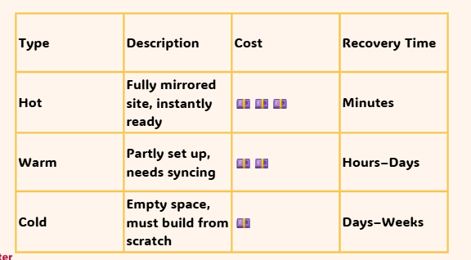
Hot, Warm and Cold Sites
Notes:
Question: if our college's main network went down, which of these would get us running the fastest?
(Hot site is the fastest but the most expensive)

Slide 29

Hot, Warm and Cold Sites
A college that can work offline for a short time
A bank processing live transactions 24/7
A local cafe that uses an online booking system occasionally
Notes:
-Which site type (Hot, warm, or cold) suits each
-One sentence explaining why
Bank - hot site (no downtime acceptable)
College - warm site (restore within a day)
Cafe - cold site (cheap, acceptable delay)

Slide 30
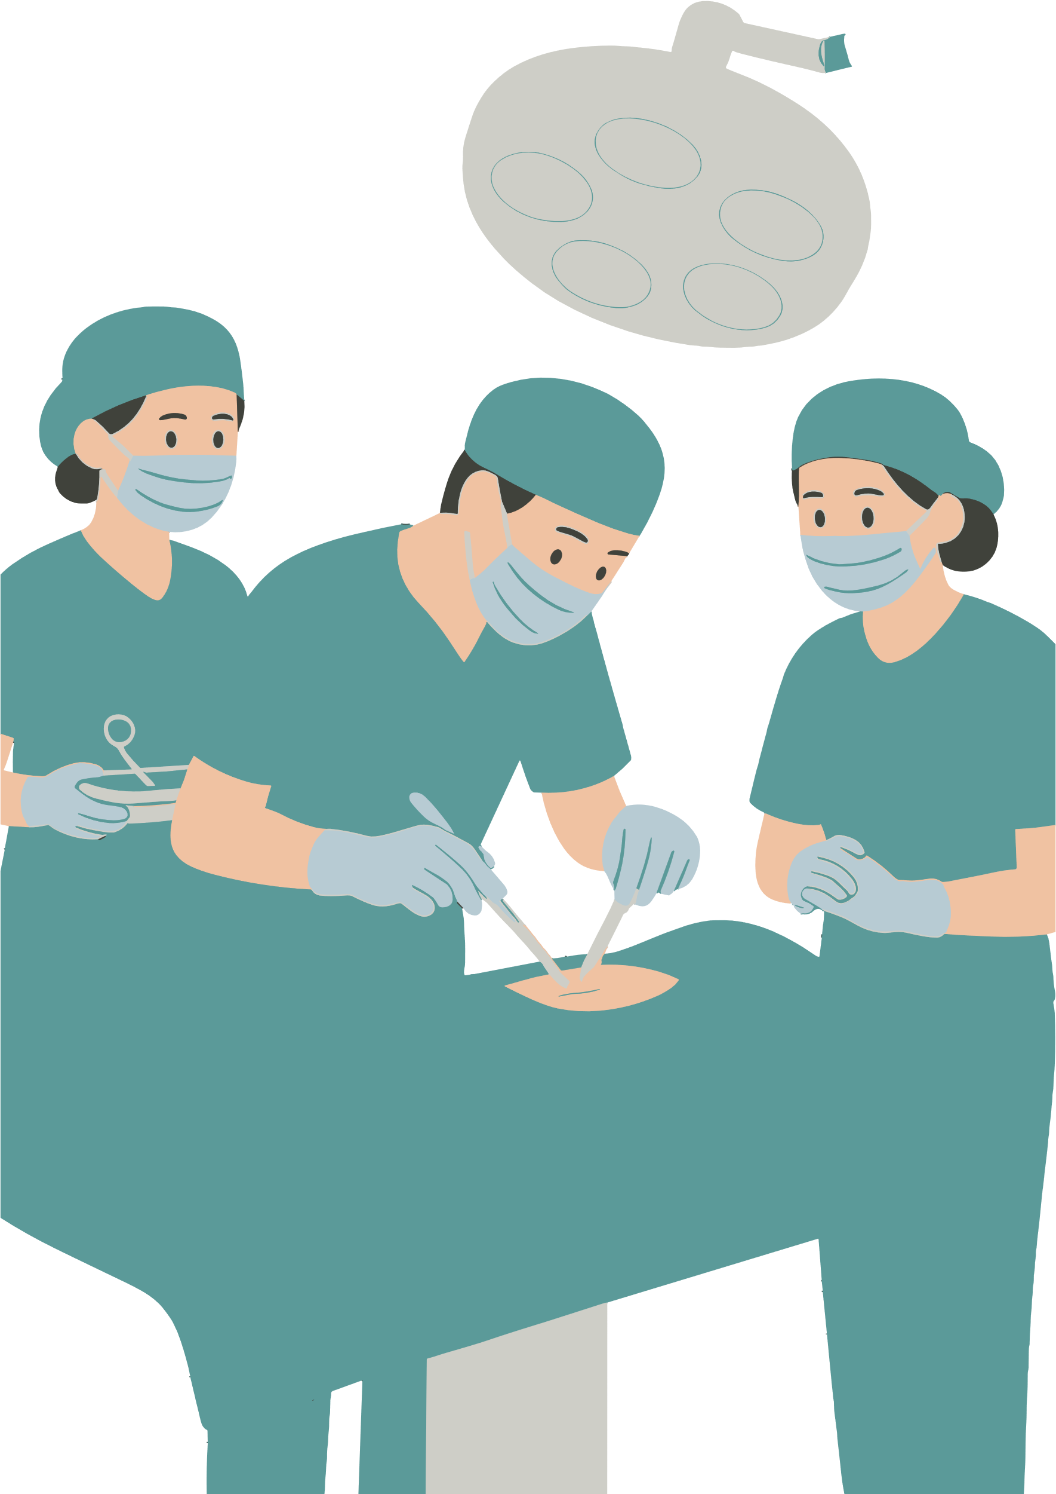
Standard operating procedures

Slide 31
Standard operating procedures
A set of step by step instructions compiled by an organisation to help workers carry out routine operations in a clear and consistent manner
i.e. a standard operating procedure for restoring a backup
Notes:
SOP’s are extremely important in disaster recovery scenarios (i.e. cyber attack, natural disaster, data loss), but can also enable the smooth running of day to day operations

Slide 32

Write an SOP that saves the day! (5 steps)
Purpose - why does the SOP exist?
Who is responsible - role/person
Steps - clear and numbered instructions
Training or induction needed?
When to review
Notes:
A good SOP will include the 5 things above
Scenarios to give to students
A new apprentice joins the IT team and needs to set up accounts safely
The college installs a new cloud backup system, staff need to learn how to use it
The organisation just updates its password policy to require MFA
The old server is being replaced, data must be transferred and drives security disposed of
A staff member accidentally deletes file, what's the recovery SOP?

Slide 33

Effective Staff Training
Training that ensures staff understand the procedures and can follow them confidently, not just read them
i.e. phishing email drills in induction
Notes:
Why does it improve resilience?
-Keeps human actions aligned with system requirements
-Reduces mistakes during updates, backups, or incident response
-Builds confidence and shared responsibility, everyone knows their role
Example: Cyber security training showing staff how to respond to suspicious emails

Slide 34

Induction
The process of introducing new employees or contractors to the organisation’s systems, policies and digital procedures
Notes:
Why does it improve resilience?
-Prevents new staff from causing accidental downtime or breaches
-Ensures consistent understanding of access rights, password policies, and system use
-Reduces the learning curve and helps them to fit into the established routine quickly
Example: A college's IT induction where new staff are shown how to log incidents in the helpdesk system

Slide 35

New Digital Systems
When an organisation introduces a new technology, such as a cloud storage platform, firewall or monitoring software. SOP’s must be updates or created to reflect new procedures
Notes:
Why does it improve resilience?
-Keeps everyone aligned on how to use the new system safely and correctly
-Ensures changes don't introduce new vulnerabilities or confusion
-Provides continuity: new tools don't break old routines
Example: Moving from local file storage to sharepoint - new SOP for file backup and permissions

Slide 36

Policies and Policy updates
Are….rules that guide behaviour
Keeps practice current and legally compliant
i.e. an updated data retention policy
Notes:
Examples
Acceptable use policy
Data protection policy (influenced by legislation such as GDPR and The Data Protection Act)
Remote working policy
Social media policy
Clear desk policy

Slide 37

Now we’ve learnt a lot of the theory, we’re going to apply our new knowledge to a scenario, analysing a case and making recommendations based on what we find.

Slide 38

Tinker
Go to the Class Notebook - class handouts section, and open ‘Resilient Environments, case study work’
Read the scenario given to you, and go through each of the steps outlined, completing the work set

Slide 39

Reflection
What was the biggest resilience weakness you found?
Which of your recommendation would make the biggest impact and why?
How does this link to one of the 3 key benefits?

Slide 40

Flipped Study/Extension
Complete the RAG list in class hand outs for the Digital Environments Module
Green means ‘I can confidently teach this to someone in 2-3 minutes with a solid example
Use this list to plan a revision schedule/create materials before the topic test in a few weeks time

